Slide 1
L2 Tensors – Multidimensional Arrays

Slide 2
Tensors
PyTorch is a library for Python programs that facilitates building deep learning projects
PyTorch is an open-source machine learning library based on the Torch library, developed by Facebook’s AI Research lab
Tensors, the basic data structure in PyTorch
The PyTorch library primarily supports NVIDIA CUDA-based GPUs

Slide 3
Transforming an input representation to an output representation
Deep learning consists of building a system that can transform data from one representation to another.
This transformation is driven by extracting commonalities from a series of examples that demonstrate the desired mapping
Floating-point numbers are the way a network deals with information
We need a way to encode real-world data and then decode the output back and use for our purpose
Hence, we need to deal with all the floating-point numbers in PyTorch by using tensors

Slide 4
Transforming an input representation to an output representation
A deep neural network typically learns the transformation from one form of data to another in stages
This means the partially transformed data between each stage can be thought of as a sequence of intermediate representations (2nd step in figure).
Intermediate representations are the results of combining the input with the weights of the previous layer of neurons.
Each intermediate representation is unique to the inputs that preceded it
For image recognition, early representations can be things such as edge detection or certain textures like fur.
Deeper representations can capture more complex structures like ears, noses, or eyes.
In general, such intermediate representations are collections of floating-point numbers that characterize the input
Such characterization is specific to the task at hand and is learned from relevant examples.
These collections of floating-point numbers and their manipulation are at the heart of modern AI

Slide 5
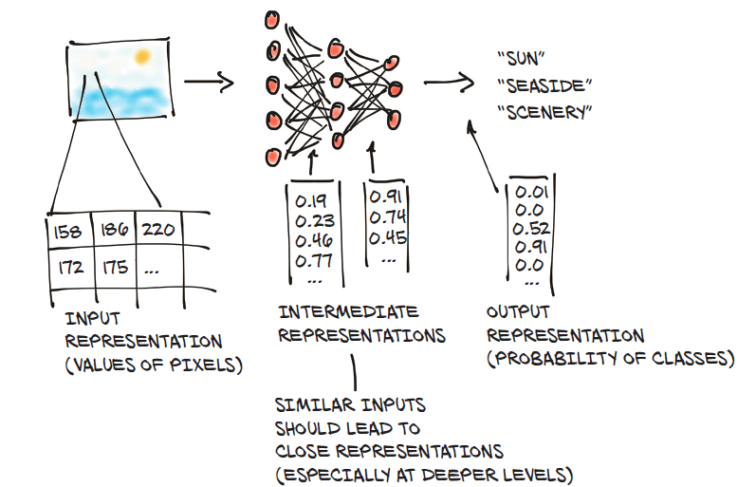
Transforming an input representation to an output representation
Converting image pixel into floating-point numbers

Slide 6
Tensors
Before we can begin the process of converting our data to floating-point input
We must need to deal with how PyTorch handles and stores data—
as input, as intermediate representations, and as output
PyTorch introduces a fundamental data structure: the tensor
In the context of deep learning, tensors refer to the generalization of vectors and matrices to an arbitrary number of dimensions
Another name for the same concept is multidimensional array.
The dimensionality of a tensor coincides with the number of indexes used to refer to scalar values within the tensor
NumPy is also popular for multidimensional array library
Compared to NumPy arrays, PyTorch tensors have a few superpowers
ability to perform very fast operations on graphical processing units (GPUs),
distribute operations on multiple devices or machines, and
keep track of the graph of computations that created them
PyTorch features seamless interoperability with NumPy, SciPy, Scikit-learn and Pandas

Slide 7
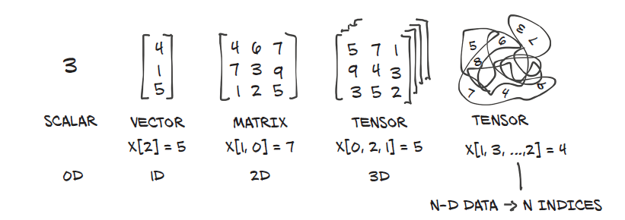
Tensors are the building blocks for representing data in PyTorch

Slide 8
Tensors vs Numpy and Tensors vs multidimensional Arrays of C, C++, Java
Tensors vs Numpy
Tensors are multidimensional arrays like n-dimensional NumPy array.
However, tensors can be used in GPUs as well, which is not in the case of NumPy array
Tensors vs multidimensional array used in C, C++, and Java
Tensors should have the same size of columns in all dimensions
Also, the tensors can contain only numeric data types

Slide 9
How to manipulate tensors using the PyTorch tensor library

Slide 10
Creating Tensor in PyTorch
A tensor can contain elements of a single data type.
We can create a tensor using a python list or NumPy array.
The torch has 10 variants of tensors for both GPU and CPU.
Different ways of defining a tensor.
torch.tensor() : It copies the data to create a tensor; however, it infers the data type automatically.
torch.Tensor() : It copies the data and creates its tensor. It is an alias for torch.FloatTensor.
torch.as_tensor() : The data is shared and not copied in this case while creating the data and accepts any type of array for tensor creation.
torch.from_numpy() : It is similar to tensor.as_tensor() however it accepts only numpy array.

Slide 11
Creating Tensor in PyTorch
Tensor: tensor([1, 2, 3, 4, 5, 6]) Data type: torch.int64
Tensor: tensor([1., 2., 3., 4., 5., 6.]) Data type: torch.float32
Tensor: tensor([1.5000, 3.4000, 6.8000, 9.3000, 7.0000, 2.8000], dtype=torch.float64) Data type: torch.float64
Tensor: tensor([1.5000, 3.4000, 6.8000, 9.3000, 7.0000, 2.8000], dtype=torch.float64) Data type: torch.float64
numpy array [1.5 3.4 6.8 9.3 7. 2.8] Data type: float64
import torch
import numpy as np
data1 = [1, 2, 3, 4, 5, 6]
data2 = np.array([1.5, 3.4, 6.8, 9.3, 7.0, 2.8])
# creating tensors and printing
t1 = torch.tensor(data1)
t2 = torch.Tensor(data1)
t3 = torch.as_tensor(data2)
t4 = torch.from_numpy(data2)
print("Tensor: ",t1, "Data type: ", t1.dtype,"\n")
print("Tensor: ",t2, "Data type: ", t2.dtype,"\n")
print("Tensor: ",t3, "Data type: ", t3.dtype,"\n")
print("Tensor: ",t4, "Data type: ", t4.dtype,"\n")
print("numpy array", data2, "Data type:", data2. dtype)
Verify that the numpy array and torch tensor have similar data types which is float64 as shown above

Slide 12
Methods for NumPy to PyTorch and PyTorch to NumPy
The two main methods for NumPy to PyTorch (and back again) are:
torch.from_numpy(ndarray) - NumPy array -> PyTorch tensor.
torch.Tensor.numpy() - PyTorch tensor -> NumPy array

Slide 13
Convert tensor to numpy array - .numpy()
Convert a PyTorch tensor to a Numpy array using the .numpy method of a tensor.
# Convert a torch tensor to a numpy array
import numpy as np
npx = np.array([[1, 2],
[3, 4.]])
ty = torch.from_numpy(npx)
print("npx=", npx)
print("ty=", ty)
print("npx.dtype=",npx.dtype)
print("ty.dtype=", ty.dtype)
npz = ty.numpy()
print("npz=",npz)
npx= [[1. 2.]
[3. 4.]]
ty= tensor([[1., 2.],
[3., 4.]], dtype=torch.float64)
npx.dtype= float64
ty.dtype= torch.float64
npz= [[1. 2.]
[3. 4.]]

Slide 14
Tensor Attributes
The two fundamental attributes of a tensor are:
Shape: refers to the dimensionality of array or matrix
Rank: refers to the number of dimensions present in tensor
TENSOR.ndim: Check number of dimensions for TENSOR or
len(TENSOR.shape)
dtype - what datatype are the elements within the tensor stored in?
device - what device is the tensor stored on? (usually GPU or CPU)

Slide 15
Create a random tensor and find details
# Create a tensor
some_tensor = torch.rand(3, 4)
# Find out details about it
print(some_tensor)
print(f"Shape of tensor: {some_tensor.shape}")
print(f"Datatype of tensor: {some_tensor.dtype}")
print(f"Device tensor is stored on: {some_tensor.device}")
tensor([[0.8549, 0.5509, 0.2868, 0.2063],
[0.4451, 0.3593, 0.7204, 0.0731],
[0.9699, 0.1078, 0.8829, 0.4132]])
Shape of tensor: torch.Size([3, 4])
Datatype of tensor: torch.float32
Device tensor is stored on: cpu

Slide 16
Tensor Attribute - .shape
t1 = torch.tensor(4.)
t2 = torch.tensor([1., 2, 3, 4])
t3 = torch.tensor([[5., 6],
[7, 8],
[9, 10]])
t4 = torch.tensor([
[[11, 12, 13],
[13, 14, 15]],
[[15, 16, 17],
[17, 18, 19.]]])
print(t1)
print(t1.shape)
print(t2)
print(t2.shape)
print(t3)
print(t3.shape)
print(t4)
print(t4.shape)
tensor(4.)
torch.Size([])
tensor([1., 2., 3., 4.])
torch.Size([4])
tensor([[ 5., 6.],
[ 7., 8.],
[ 9., 10.]])
torch.Size([3, 2])
tensor([[[11., 12., 13.],
[13., 14., 15.]],
[[15., 16., 17.],
[17., 18., 19.]]])
torch.Size([2, 2, 3])

Slide 17
Tensor Attribute - .shape
import torch
# creating a tensors
t1=torch.tensor([1, 2, 3, 4])
t2=torch.tensor([[1, 2, 3, 4],
[5, 6, 7, 8],
[9, 10, 11, 12]])
# printing the tensors:
print("Tensor t1: \n", t1)
print("\nTensor t2: \n", t2)
# shape of tensors
print("\nShape of t1: ", t1.shape)
print(“Shape of t2: ", t2.shape)
# rank of tensors
print("\nRank of t1: ", len(t1.shape))
print("Rank of t2: ", len(t2.shape))
Tensor t1:
tensor([1, 2, 3, 4])
Tensor t2:
tensor([[ 1, 2, 3, 4],
[ 5, 6, 7, 8],
[ 9, 10, 11, 12]])
Shape of t1: torch.Size([4])
Shape of t2: torch.Size([3, 4])
Rank of t1: 1
Rank of t2: 2

Slide 18
Restructuring Tensors in Pytorch
We can modify the shape and size of a tensor as desired in PyTorch.
We can also create a transpose of an n-d tensor.
Three common ways to change the structure of tensor :
.reshape(a, b) : returns a new tensor with size a,b
.resize(a, b) : returns the same tensor with the size a,b
.transpose(a, b) : returns a tensor transposed in a and b dimension
transposes in PyTorch use either:
torch.transpose(input, dim0, dim1) - where input is the desired tensor to transpose and dim0 and dim1 are the dimensions to be swapped.
tensor.T - where tensor is the desired tensor to transpose.

Slide 19
Restructuring Tensors in Pytorch
Transpose Parameters
input (Tensor) – the input tensor.
dim0 (int) – the first dimension to be transposed
dim1 (int) – the second dimension to be transposed
transpose(0, 1) (or transpose(): defaults to swapping the first two dimensions)
for a 2D tensor, transpose(0, 1) and transpose(1, 0) have the same effect—they transpose the matrix. The difference is with tensors of higher dimensions
x = torch.randn(2, 3)
print(x)
torch.transpose(x, 0, 1)
tensor([[ 0.0094, 0.3476, 0.5798],
[ 0.5781, 0.6393, -1.6365]])
tensor([[ 0.0094, 0.5781],
[ 0.3476, 0.6393],
[ 0.5798, -1.6365]])

Slide 20
Restructuring Tensors in Pytorch
import torch
# defining tensor
t = torch.tensor([[1, 2, 3, 4],
[5, 6, 7, 8],
[9, 10, 11, 12]])
# reshaping the tensor
print("Reshaping")
print(t.reshape(6, 2))
# resizing the tensor
print("\nResizing")
print(t.resize_(2, 6))
# transposing the tensor
print("\nTransposing")
print(t.transpose(1, 0))
Reshaping
tensor([[ 1, 2],
[ 3, 4],
[ 5, 6],
[ 7, 8],
[ 9, 10],
[11, 12]])
Resizing
tensor([[ 1, 2, 3, 4, 5, 6],
[ 7, 8, 9, 10, 11, 12]])
Transposing
tensor([[ 1, 7],
[ 2, 8],
[ 3, 9],
[ 4, 10],
[ 5, 11],
[ 6, 12]])

Slide 21
Restructuring Tensors in Pytorch - reshape vs resize
import torch
original_tensor = torch.tensor([[1, 2, 3], [4, 5, 6]])
# Reshape example
new_shape = (3, 2)
reshaped_tensor = original_tensor.reshape(new_shape)
print("Original Tensor:")
print(original_tensor)
print("Reshaped Tensor:")
print(reshaped_tensor)
print()
# Resize example (inplace)
new_size = (3, 2)
original_tensor.resize_(new_size)
print("Resized Tensor (inplace):")
print(original_tensor)
print()
# Transpose example
transposed_tensor = original_tensor.transpose(0, 1)
print("Original Tensor:")
print(original_tensor)
print("Transposed Tensor:")
print(transposed_tensor)
Original Tensor:
tensor([[1, 2, 3],
[4, 5, 6]])
Reshaped Tensor:
tensor([[1, 2],
[3, 4],
[5, 6]])
Resized Tensor (inplace):
tensor([[1, 2],
[3, 4],
[5, 6]])
Original Tensor:
tensor([[1, 2],
[3, 4],
[5, 6]])
Transposed Tensor:
tensor([[1, 3, 5],
[2, 4, 6]])

Slide 22
Reshape vs resize vs Transpose
reshape
The reshape operation is used to change the shape of the tensor. In this example, the original tensor is reshaped from a 2x3 matrix to a 3x2 matrix.
The reshape operation is used to change the shape of a tensor while keeping the same underlying data. It creates a new view of the original tensor with the specified shape.
resize (Inplace):
The resize_ operation is an inplace operation used to change the size of the tensor. Here, the original tensor is resized to a new size of 3x2.
The resize_ method is the inplace version that modifies the original tensor. It's recommended to use inplace operations to avoid deprecated warnings
transpose
The transpose operation is used to swap dimensions of the tensor. There is no inplace version of transpose. It always returns a new tensor

Slide 23
Mathematical Operations on Tensors in PyTorch
We can perform various mathematical operations on tensors using Pytorch similar to NumPy arrays
Also works with operators - +, - *, /
import torch
# defining two tensors
t1 = torch.tensor([1, 2, 3, 4])
t2 = torch.tensor([5, 6, 7, 8])
# adding two tensors
print("tensor2 + tensor1")
print(torch.add(t2, t1))
# subtracting two tensor
print("\ntensor2 - tensor1")
print(torch.sub(t2, t1))
# multiplying two tensors
print("\ntensor2 * tensor1")
print(torch.mul(t2, t1))
# diving two tensors
print("\ntensor2 / tensor1")
print(torch.div(t2, t1))
tensor2 + tensor1
tensor([ 6, 8, 10, 12])
tensor2 - tensor1
tensor([4, 4, 4, 4])
tensor2 * tensor1
tensor([ 5, 12, 21, 32])
tensor2 / tensor1
tensor([5.0000, 3.0000, 2.3333, 2.0000])

Slide 24
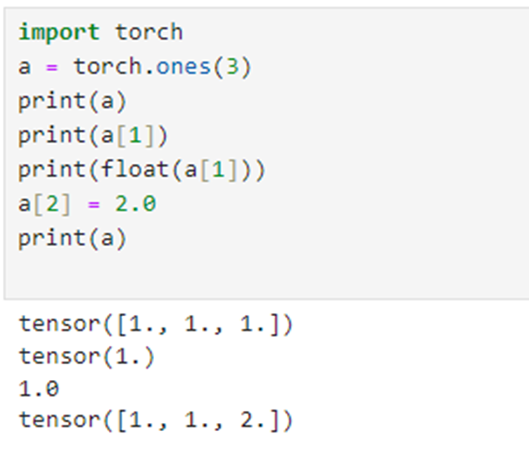
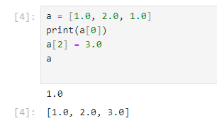
From Python lists to PyTorch tensors
List indexing vs Tensor indexing
List of three numbers in Python
Import the torch module
Creates a one-dimensional tensor of size 3 filled with 1s
How tensors are different from a list ? The essence of tensors

Slide 25
The essence of tensors
Python lists or tuples of numbers are collections of Python objects that are individually allocated in memory (left side figure)
PyTorch tensors or NumPy arrays, on the other hand, are views over (typically) contiguous memory blocks containing unboxed C numeric types rather than Python objects.
Each element is a 32-bit (4-byte) float in this case (right side of figure )
This means storing a 1D tensor of 1,000,000 float numbers will require exactly 4,000,000 contiguous bytes, plus a small overhead for the metadata (such as dimensions and numeric type).

Slide 26
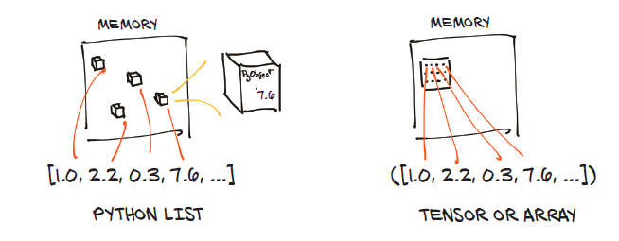
The essence of tensors

Slide 27
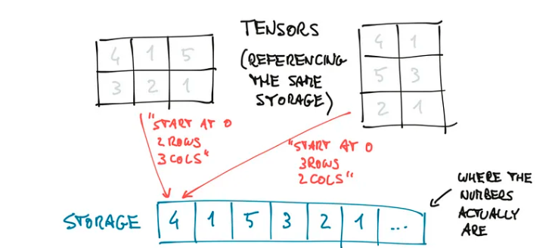
Tensors are views over a Storage instance

Slide 28
Matrix Multiplication using PyTorch
The methods in PyTorch expect the inputs to be a Tensor
Matrix multiplication methods:
torch.mm()
torch.matmul()
torch.bmm()
@ operator
# torch.mm is a shortcut for matmul

Slide 29
Matrix multiplication using transpose
# Perform matmul on tensor_A and tensor_B
tensor_A = torch.rand(size=(2,3)).to(device)
tensor_B = torch.rand(size=(2,3)).to(device)
print("tensor_A=", tensor_A)
print("tensor_B=", tensor_B)
# tensor_C = torch.matmul(tensor_A, tensor_B) # won't work because of shape error
print("tensor_B.T=", tensor_B.T)
tensor_C = torch.matmul(tensor_A, tensor_B.T)
print("tensor_C=", tensor_C, tensor_C.shape)

Slide 30
Matrix multiplication using transpose
tensor_A= tensor([[0.0108, 0.9455, 0.7661],
[0.2634, 0.1880, 0.5174]])
tensor_B= tensor([[0.7849, 0.1412, 0.3112],
[0.7091, 0.1775, 0.4443]])
tensor_B.T= tensor([[0.7849, 0.7091],
[0.1412, 0.1775],
[0.3112, 0.4443]])
tensor_C= tensor([[0.3803, 0.5159],
[0.3943, 0.4501]]) torch.Size([2, 2])

Slide 31
Matrix Multiplication using PyTorch - torch.mm()
Computes matrix multiplication by taking an m×n Tensor and an n×p Tensor.
It can deal with only two-dimensional matrices and not with single-dimensional ones.
This function does not support broadcasting.
Broadcasting is the way the Tensors are treated when their shapes are different.
The smaller Tensor is broadcasted to suit the shape of the wider or larger Tensor for operations.
torch.mm(Tensor_1, Tensor_2, out=None)
The parameters are two Tensors and the third one is an optional argument. Another Tensor to hold the output values can be given there.

Slide 32
Matrix Multiplication using PyTorch - torch.mm()
Ex1: Same dimensions
import torch
mat_1 = torch.tensor([[1, 2, 3],
[4, 3, 8],
[1, 7, 2]])
mat_2 = torch.tensor([[2, 4, 1],
[1, 3, 6],
[2, 6, 5]])
torch.mm(mat_1, mat_2, out=None)
Ex2: tensor_1 is of 2×2 dimension, tensor_2 is of 2×3 dimension.
So the output will be of 2×3
import torch
mat_1 = torch.tensor([[1, 2], [4, 3]])
mat_2 = torch.tensor([[2, 4, 1], [1, 3, 6]])
torch.mm(mat_1, mat_2, out=None)

Slide 33
Matrix Multiplication using PyTorch - torch.mm()
Ex1: Same dimensions
import torch
mat_1 = torch.tensor([[1, 2, 3],
[4, 3, 8],
[1, 7, 2]])
mat_2 = torch.tensor([[2, 4, 1],
[1, 3, 6],
[2, 6, 5]])
torch.mm(mat_1, mat_2, out=None)
Ex2: tensor_1 is of 2×2 dimension, tensor_2 is of 2×3 dimension.
So the output will be of 2×3
import torch
mat_1 = torch.tensor([[1, 2], [4, 3]])
mat_2 = torch.tensor([[2, 4, 1], [1, 3, 6]])
torch.mm(mat_1, mat_2, out=None)
tensor([[10, 28, 28],
[27, 73, 62],
[13, 37, 53]])
tensor([[ 4, 10, 13],
[11, 25, 22]])

Slide 34
Matrix Multiplication using PyTorch - torch.matmul()
Allows the computation of multiplication of single-dimensional matrices, 2D matrices and mixed ones also.
This method also supports broadcasting and batch operations.
Depending upon the input matrices dimensions, the operation to be done is decided.
The general syntax is given below.
torch.matmul(Tensor_1, Tensor_2, out=None)

Slide 35
Matrix Multiplication using PyTorch - torch.matmul()
Various possible dimensions of the arguments and the operations
argument_1 | argument_2 | Action taken
1-dimensional | 1-dimensional | The dot product (scalar) is calculated
2-dimensional | 2-dimensional | General matrix multiplication is done
1-dimensional | 2-dimensional | The tensor-1 is prepended with a ‘1’ to match dimension of tensor-2 a 1 for the purpose of the matrix multiply. After the matrix multiply, the prepended dimension is removed.
2-dimensional | 1-dimensional | Matrix-vector product is calculated
1/N-dimensional (N>2) | 1/N-dimensional (N>2) | Batched matrix multiplication is done

Slide 36
Matrix Multiplication using PyTorch - torch.matmul()
Ex1: Arguments of the same dimension
import torch
vec_1 = torch.tensor([3, 6, 2])
vec_2 = torch.tensor([4, 1, 9])
print("Single dimensional tensors :", torch.matmul(vec_1, vec_2))
# both arguments 2D
mat_1 = torch.tensor([[1, 2, 3],
[4, 3, 8],
[1, 7, 2]])
mat_2 = torch.tensor([[2, 4, 1],
[1, 3, 6],
[2, 6, 5]])
out = torch.matmul(mat_1, mat_2)
print("\n3x3 dimensional tensors :\n", out)

Slide 37
Matrix Multiplication using PyTorch - torch.matmul()
Ex1: Arguments of the same dimension
import torch
vec_1 = torch.tensor([3, 6, 2])
vec_2 = torch.tensor([4, 1, 9])
print("Single dimensional tensors :", torch.matmul(vec_1, vec_2))
# both arguments 2D
mat_1 = torch.tensor([[1, 2, 3],
[4, 3, 8],
[1, 7, 2]])
mat_2 = torch.tensor([[2, 4, 1],
[1, 3, 6],
[2, 6, 5]])
out = torch.matmul(mat_1, mat_2)
print("\n3x3 dimensional tensors :\n", out)
3*4+6*1+2*9=36
Single dimensional tensors : tensor(36)
3x3 dimensional tensors :
tensor([[10, 28, 28],
[27, 73, 62],
[13, 37, 53]])

Slide 38
Matrix Multiplication using PyTorch - torch.matmul()
Ex1: Arguments of different dimensions
import torch
# first argument 1D and second argument 2D
mat1_1 = torch.tensor([3, 6, 2])
mat1_2 = torch.tensor([[1, 2, 3],
[4, 3, 8],
[1, 7, 2]])
out_1 = torch.matmul(mat1_1, mat1_2)
print("\n1D-2D multiplication :\n", out_1)
# first argument 2D and second argument 1D
mat2_1 = torch.tensor([[2, 4, 1],
[1, 3, 6],
[2, 6, 5]])
mat2_2 = torch.tensor([4, 1, 9])
# assigning to output tensor
out_2 = torch.matmul(mat2_1, mat2_2)
print("\n2D-1D multiplication :\n", out_2)

Slide 39
Matrix Multiplication using PyTorch - torch.matmul()
Ex1: Arguments of different dimensions
import torch
# first argument 1D and second argument 2D
mat1_1 = torch.tensor([3, 6, 2])
mat1_2 = torch.tensor([[1, 2, 3],
[4, 3, 8],
[1, 7, 2]])
out_1 = torch.matmul(mat1_1, mat1_2)
print("\n1D-2D multiplication :\n", out_1)
# first argument 2D and second argument 1D
mat2_1 = torch.tensor([[2, 4, 1],
[1, 3, 6],
[2, 6, 5]])
mat2_2 = torch.tensor([4, 1, 9])
# assigning to output tensor
out_2 = torch.matmul(mat2_1, mat2_2)
print("\n2D-1D multiplication :\n", out_2)
1D-2D multiplication :
tensor([29, 38, 61])
2D-1D multiplication :
tensor([21, 61, 59])

Slide 40
Matrix Multiplication using PyTorch - torch.matmul()
Ex3: N-dimensional argument (N>2)
import torch
# creating Tensors using randn()
mat_1 = torch.randn(2, 3, 3)
mat_2 = torch.randn(3)
# printing the matrices
print("matrix A :\n", mat_1)
print("\nmatrix B :\n", mat_2)
# output
print("\nOutput :\n", torch.matmul(mat_1, mat_2))

Slide 41
Matrix Multiplication using PyTorch - torch.matmul()
matrix A :
tensor([[[ 0.3437, -0.1045, 0.2069],
[-0.7087, 3.0298, 1.8346],
[ 1.0761, -0.2179, -0.0404]],
[[ 0.9028, 0.6267, -0.6288],
[-0.3468, -0.3376, 1.8786],
[-0.9405, -0.8161, 0.2485]]])
matrix B :
tensor([-0.6310, -0.3815, -0.3336])
Output :
tensor([[-0.2460, -1.3208, -0.5824],
[-0.5990, -0.2790, 0.8220]])
Ex3: N-dimensional argument (N>2)
import torch
# creating Tensors using randn()
mat_1 = torch.randn(2, 3, 3)
mat_2 = torch.randn(3)
# printing the matrices
print("matrix A :\n", mat_1)
print("\nmatrix B :\n", mat_2)
# output
print("\nOutput :\n", torch.matmul(mat_1, mat_2))

Slide 42
Matrix Multiplication using PyTorch - torch.bmm()
provides batched matrix multiplication for the cases where both the matrices to be multiplied are of only 3-Dimensions (x×y×z) and the first dimension (x) of both the matrices must be same.
This does not support broadcasting. The syntax is as given below.
torch.bmm( Tensor_1, Tensor_2, deterministic=false, out=None)
The “deterministic” parameter takes up boolean value. A ‘false‘ does a faster calculation which is non-deterministic.
A ‘true‘ does a slower calculation however, it is deterministic.

Slide 43
Matrix Multiplication using PyTorch - torch.bmm()
Ex: the matrix_1 is of dimension 2×3×3. The second matrix is of dimension 2×3×4.
import torch
# 3D matrices
mat_1 = torch.randn(2, 3, 3)
mat_2 = torch.randn(2, 3, 4)
print("matrix A :\n",mat_1)
print("\nmatrix B :\n",mat_2)
print("\nOutput :\n",torch.bmm(mat_1,mat_2))

Slide 44
Matrix Multiplication using PyTorch - torch.bmm()
matrix A :
tensor([[[ 0.8639, 1.6221, 0.1931],
[ 2.3902, 0.3274, -1.7375],
[ 0.6995, -0.2053, -0.5686]],
[[-0.9331, -0.3916, -0.8546],
[-0.5468, -1.8374, -0.3086],
[-2.2238, -1.2308, -1.0526]]])
matrix B :
tensor([[[-7.7382e-02, 5.3086e-01, -1.6793e+00, -2.2021e+00],
[ 1.1075e+00, -6.5119e-01, 8.2038e-04, 1.1264e-01],
[-4.5405e-01, 6.0790e-01, -4.1423e-01, -3.0507e-01]],
[[ 1.1997e+00, -1.0194e+00, 4.8544e-02, 6.8989e-01],
[ 3.3041e-01, -9.4842e-01, -1.0319e+00, -5.3241e-01],
[-5.0360e-01, 4.0240e-01, -8.7856e-02, 1.1704e-01]]])
Output :
tensor([[[ 1.6419e+00, -4.8024e-01, -1.5295e+00, -1.7787e+00],
[ 9.6655e-01, -5.3465e-04, -3.2939e+00, -4.6965e+00],
[-2.3310e-02, 1.5936e-01, -9.3928e-01, -1.3900e+00]],
[[-8.1845e-01, 9.7871e-01, 4.3389e-01, -5.3530e-01],
[-1.1076e+00, 2.1758e+00, 1.8967e+00, 5.6492e-01],
[-2.5444e+00, 3.0107e+00, 1.2547e+00, -1.0021e+00]]])

Slide 45
Matrix Multiplication using PyTorch - @ operator
@ operator:
The @ – Simon H operator, when applied on matrices performs multiplication element-wise on 1D matrices and
normal matrix multiplication on 2D matrices.
If both the matrices have the same dimension, then the matrix multiplication is carried out normally without any broadcasting/prepending.
If any one of the matrices is of a different dimension, then appropriate broadcasting is carried out first and then the multiplication is carried out.
This operator applies to N-Dimensional matrices also

Slide 46
Matrix Multiplication using PyTorch - @ operator
# single dimensional matrices
oneD_1 = torch.tensor([3, 6, 2])
oneD_2 = torch.tensor([4, 1, 9])
# two dimensional matrices
twoD_1 = torch.tensor([[1, 2, 3],
[4, 3, 8],
[1, 7, 2]])
twoD_2 = torch.tensor([[2, 4, 1],
[1, 3, 6],
[2, 6, 5]])
# N-dimensional matrices (N>2)
# 2x3x3 dimensional matrix
ND_1 = torch.tensor([[[-0.0135, -0.9197, -0.3395],
[-1.0369, -1.3242, 1.4799],
[-0.0182, -1.2917, 0.6575]],
[[-0.3585, -0.0478, 0.4674],
[-0.6688, -0.9217, -1.2612],
[1.6323, -0.0640, 0.4357]]])
# 2x3x4 dimensional matrix
ND_2 = torch.tensor([[[0.2431, -0.1044, -0.1437, -1.4982],
[-1.4318, -0.2510, 1.6247, 0.5623],
[1.5265, -0.8568, -2.1125, -0.9463]],
[[0.0182, 0.5207, 1.2890, -1.3232],
[-0.2275, -0.8006, -0.6909, -1.0108],
[1.3881, -0.0327, -1.4890, -0.5550]]])
print("1D matrices output :\n", oneD_1 @ oneD_2)
print("\n2D matrices output :\n", twoD_1 @ twoD_2)
print("\nN-D matrices output :\n", ND_1 @ ND_2)
print("\n Mixed matrices output :\n", oneD_1 @ twoD_1 @ twoD_2)

Slide 47
Matrix Multiplication using PyTorch - @ operator
1D matrices output :
tensor(36)
2D matrices output :
tensor([[10, 28, 28],
[27, 73, 62],
[13, 37, 53]])
N-D matrices output :
tensor([[[ 0.7953, 0.5231, -0.7751, -0.1757],
[ 3.9030, -0.8274, -5.1287, -0.5915],
[ 2.8487, -0.2372, -3.4850, -1.3212]],
[[ 0.6531, -0.1637, -1.1250, 0.2633],
[-1.5532, 0.4309, 1.6526, 2.5166],
[ 0.6491, 0.8869, 1.4995, -2.3370]]])
Mixed matrices output :
tensor([218, 596, 562])

